Slide 1
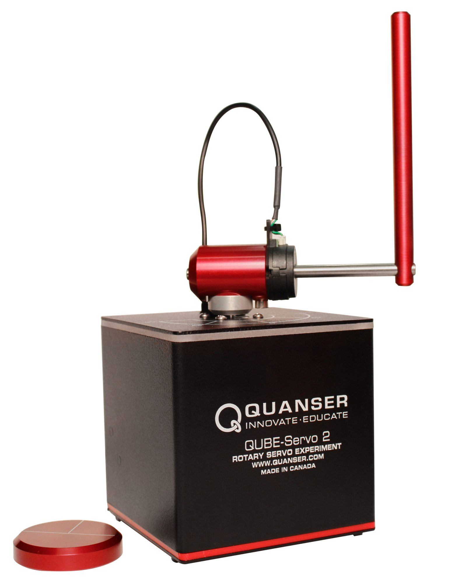
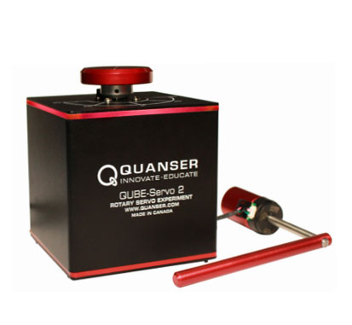
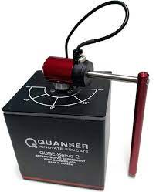
Automation and Control Laboratory
Inverted Pendulum Control
FRANCESCO CERESETTI - ALESSANDRO COLOMBO – GIACOMO DELCARO – PAOLO FUSCO

Slide 2
System Description
The system is composed by:
DC motor
Horizontal Rod, moved by the motor around an axis perpendicular to the ground
Vertical Rod (Pendulum), which is free to rotate around the horizontal rod axis
The control action is the motor Voltage
The available sensors are two angular position encoders for the position of the horizontal rod and of the pendulum.

Slide 3
MODEL
EQUATIONS

Slide 4
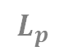
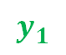
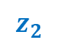
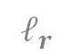
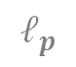

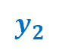

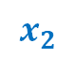
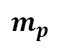

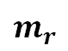
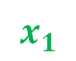
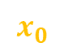
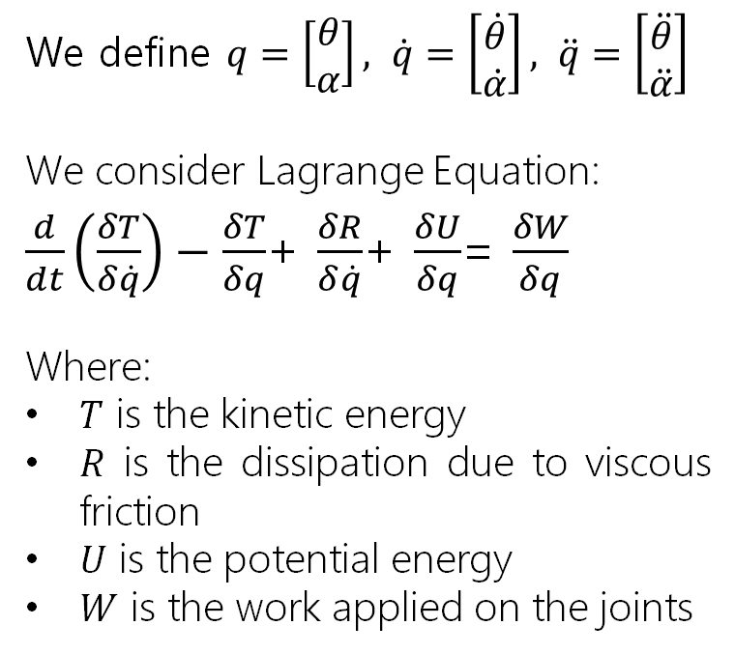


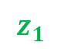
Model Equations
Let us consider the following model for the pendulum:
$$L_{r}$$
$$z_{1}$$
We define $q=\left[\begin{aligned}θ \\ α\end{aligned}\right], \dot{q}=\left[\begin{aligned}\dot{θ} \\ \dot{α}\end{aligned}\right], \ddot{q}=\left[\begin{aligned}\ddot{θ} \\ \ddot{α}\end{aligned}\right]$
We consider Lagrange Equation:
$\frac{d}{dt}\left(\frac{δT}{δ\dot{q}}\right)−\frac{δT}{δq}$+ $\frac{δR}{δ\dot{q}}$+ $\frac{δU}{δq}$= $\frac{δW}{δq}$
Where:
$T$ is the kinetic energy
$R$ is the dissipation due to viscous friction
$U$ is the potential energy
$W$ is the work applied on the joints
$$ℓ_{r}$$
$$m_{r}$$
$$z_{0}$$
$$x_{1}$$
ROD
$$y_{1}$$
$$ℓ_{p}$$
$$θ$$
$$y_{0}$$
$$L_{p}$$
$$x_{0}$$
$$m_{p}$$
PENDULUM
$$α$$
$$x_{2}$$
$$y_{2}$$
$$z_{2}$$

Slide 5
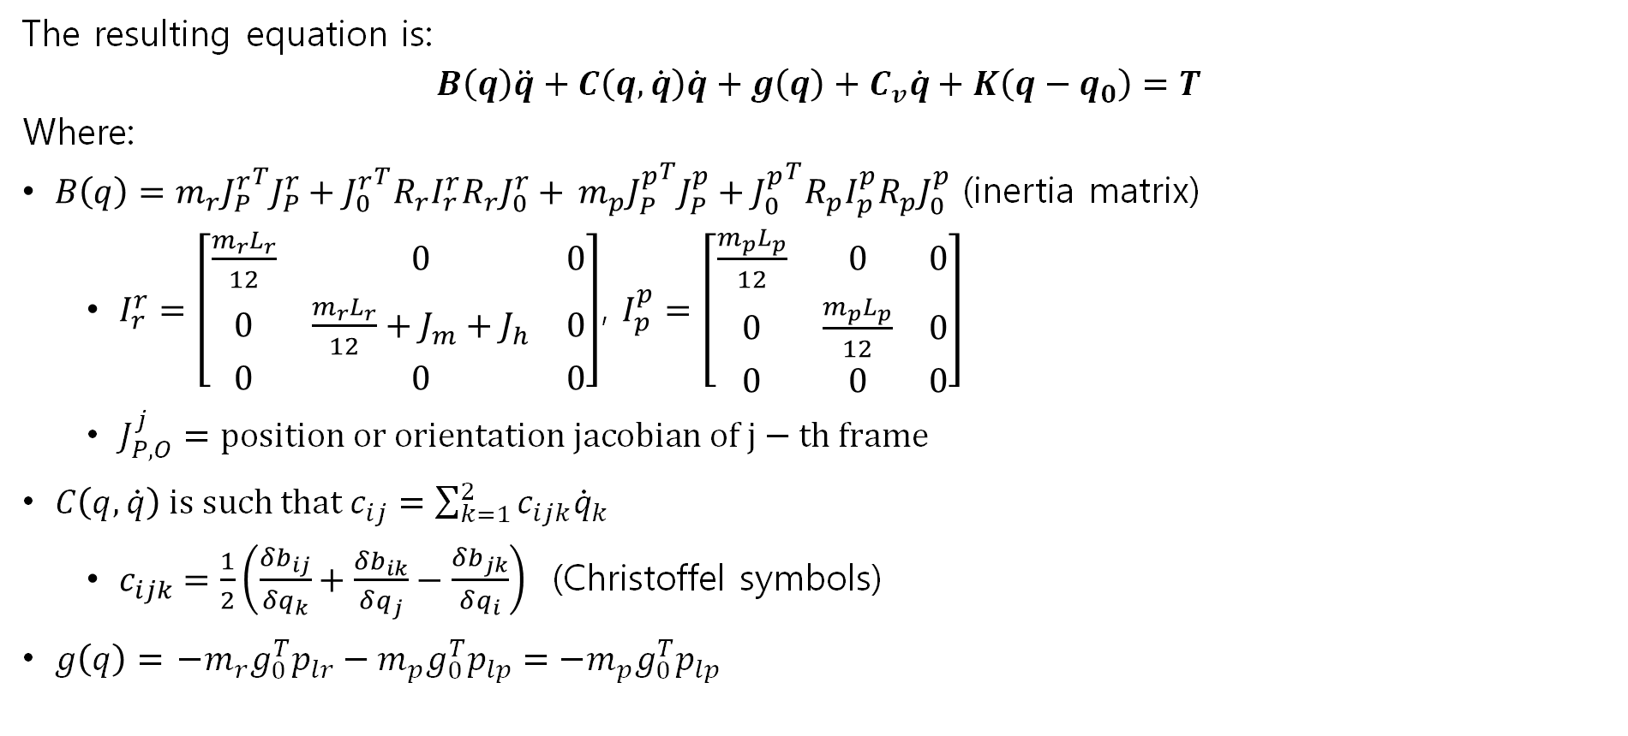
Model Equations
The resulting equation is:
$$B\left(q\right)\ddot{q}+C\left(q,\dot{q}\right)\dot{q}+g\left(q\right)+C_{v}\dot{q}+K\left(q−q_{0}\right)=T$$
Where:
$B\left(q\right)=m_{r}{J_{P}^{r}}^{T}J_{P}^{r}+{J_{0}^{r}}^{T}R_{r}I_{r}^{r}R_{r}J_{0}^{r}+$ $m_{p}{J_{P}^{p}}^{T}J_{P}^{p}+{J_{0}^{p}}^{T}R_{p}I_{p}^{p}R_{p}J_{0}^{p}$ (inertia matrix)
$I_{r}^{r}=\left[\begin{matrix}\frac{m_{r}L_{r}}{12} & 0 & 0 \\ 0 & \frac{m_{r}L_{r}}{12}+J_{m}+J_{h} & 0 \\ 0 & 0 & 0\end{matrix}\right]$, $I_{p}^{p}=\left[\begin{matrix}\frac{m_{p}L_{p}}{12} & 0 & 0 \\ 0 & \frac{m_{p}L_{p}}{12} & 0 \\ 0 & 0 & 0\end{matrix}\right]$
$J_{P,O}^{j}=position or orientation jacobian of j−th frame$
$C\left(q,\dot{q}\right) is such that c_{ij}=\sum_{k=1}^{2}{c_{ijk}{\dot{q}}_{k}}$
$c_{ijk}=\frac{1}{2}\left(\frac{δb_{ij}}{δq_{k}}+\frac{δb_{ik}}{δq_{j}}−\frac{δb_{jk}}{δq_{i}}\right)$ (Christoffel symbols)
$g\left(q\right)=$ $−m_{r}g_{0}^{T}p_{lr}−m_{p}g_{0}^{T}p_{lp}=−m_{p}g_{0}^{T}p_{lp}$

Slide 6
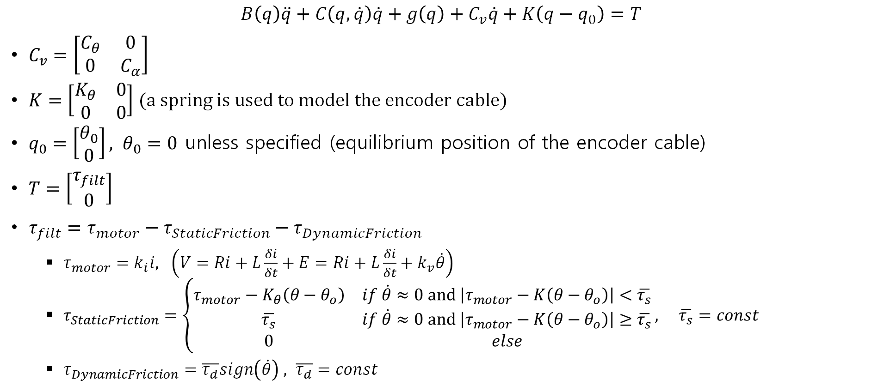
Model Equations
$$B\left(q\right)\ddot{q}+C\left(q,\dot{q}\right)\dot{q}+g\left(q\right)+C_{v}\dot{q}+K\left(q−q_{0}\right)=T$$
$C_{v}=\left[\begin{matrix}C_{θ} & 0 \\ 0 & C_{α}\end{matrix}\right]$
$K=\left[\begin{matrix}K_{θ} & 0 \\ 0 & 0\end{matrix}\right]$ (a spring is used to model the encoder cable)
$q_{0}=\left[\begin{aligned}θ_{0} \\ 0\end{aligned}\right], θ_{0}=0$ unless specified (equilibrium position of the encoder cable)
$T=\left[\begin{aligned}τ_{filt} \\ 0\end{aligned}\right]$
$τ_{filt}=τ_{motor}−τ_{StaticFriction}−τ_{DynamicFriction}$
$τ_{motor}=k_{i}i, \left(V=Ri+L\frac{δi}{δt}+E=Ri+L\frac{δi}{δt}+k_{v}\dot{θ}\right)$
$τ_{StaticFriction}=\left\{\begin{matrix}τ_{motor}−K_{θ}\left(θ−θ_{o}\right) & if \dot{θ}≈0 and \left|τ_{motor}−K\left(θ−θ_{o}\right)\right|<\overline{τ_{s}} \\ \overline{τ_{s}} & if \dot{θ}≈0 and \left|τ_{motor}−K\left(θ−θ_{o}\right)\right|≥\overline{τ_{s}} \\ 0 & else\end{matrix}\right., \overline{τ_{s}}=const$
$τ_{DynamicFriction}=\overline{τ_{d}}sign\left(\dot{θ}\right) , \overline{τ_{d}}=const$

Slide 7
SYSTEM IDENTIFICATION

Slide 8
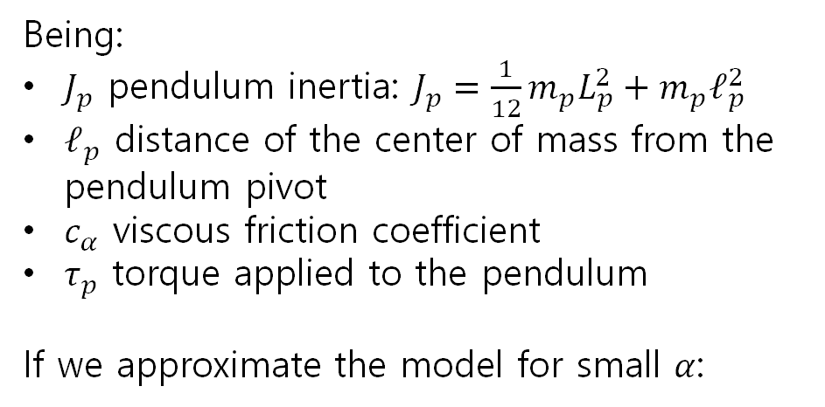
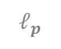
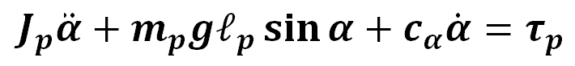
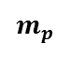
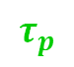

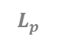
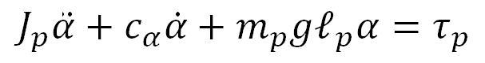
Pendulum Model
We will start with the pendulum parameters identification.
If we consider a system only made by the pendulum, the dynamic relations can be written as:
$$J_{p}\ddot{α}+m_{p}gℓ_{p}\sin{α}+c_{α}\dot{α}=τ_{p}$$
$$τ_{p}$$
$$ℓ_{p}$$
Being:
$J_{p}$ pendulum inertia: $J_{p}=\frac{1}{12}m_{p}L_{p}^{2}+m_{p}ℓ_{p}^{2}$
$ℓ_{p}$ distance of the center of mass from the pendulum pivot
$c_{α}$ viscous friction coefficient
$τ_{p}$ torque applied to the pendulum
If we approximate the model for small $α$:
$$L_{p}$$
$$m_{p}$$
PENDULUM
$$α$$
$$J_{p}\ddot{α}+{c_{α}\dot{α}+m}_{p}gℓ_{p}α=τ_{p}$$

Slide 9
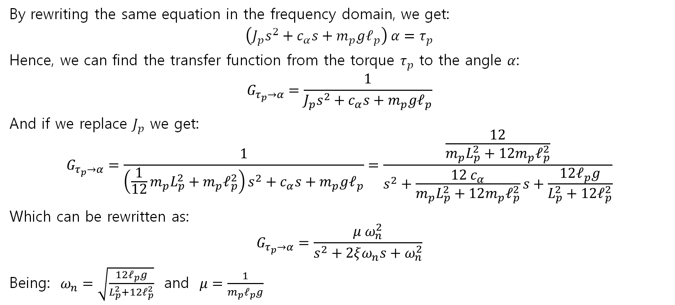
Pendulum Model
By rewriting the same equation in the frequency domain, we get:
$$\left(J_{p}s^{2}+{c_{α}s+m}_{p}gℓ_{p}\right) α=τ_{p}$$
Hence, we can find the transfer function from the torque $τ_{p}$ to the angle $α$:
$$G_{τ_{p}→α}=\frac{1}{J_{p}s^{2}+{c_{α}s+m}_{p}gℓ_{p}}$$
And if we replace $J_{p}$ we get:
$$G_{τ_{p}→α}=\frac{1}{\left(\frac{1}{12}m_{p}L_{p}^{2}+m_{p}ℓ_{p}^{2}\right)s^{2}+{c_{α}s+m}_{p}gℓ_{p}}=\frac{\frac{12}{m_{p}L_{p}^{2}+12m_{p}ℓ_{p}^{2}}}{s^{2}+\frac{12 c_{α}}{m_{p}L_{p}^{2}+12m_{p}ℓ_{p}^{2}}s+\frac{12ℓ_{p}g}{L_{p}^{2}+12ℓ_{p}^{2}}}$$
Which can be rewritten as:
$$G_{τ_{p}→α}=\frac{μ ω_{n}^{2}}{s^{2}+2ξω_{n}s+ω_{n}^{2}}$$
Being: $ω_{n}=\sqrt{\frac{12ℓ_{p}g}{L_{p}^{2}+12ℓ_{p}^{2}}}$ and $μ=\frac{1}{m_{p}ℓ_{p}g}$

Slide 10
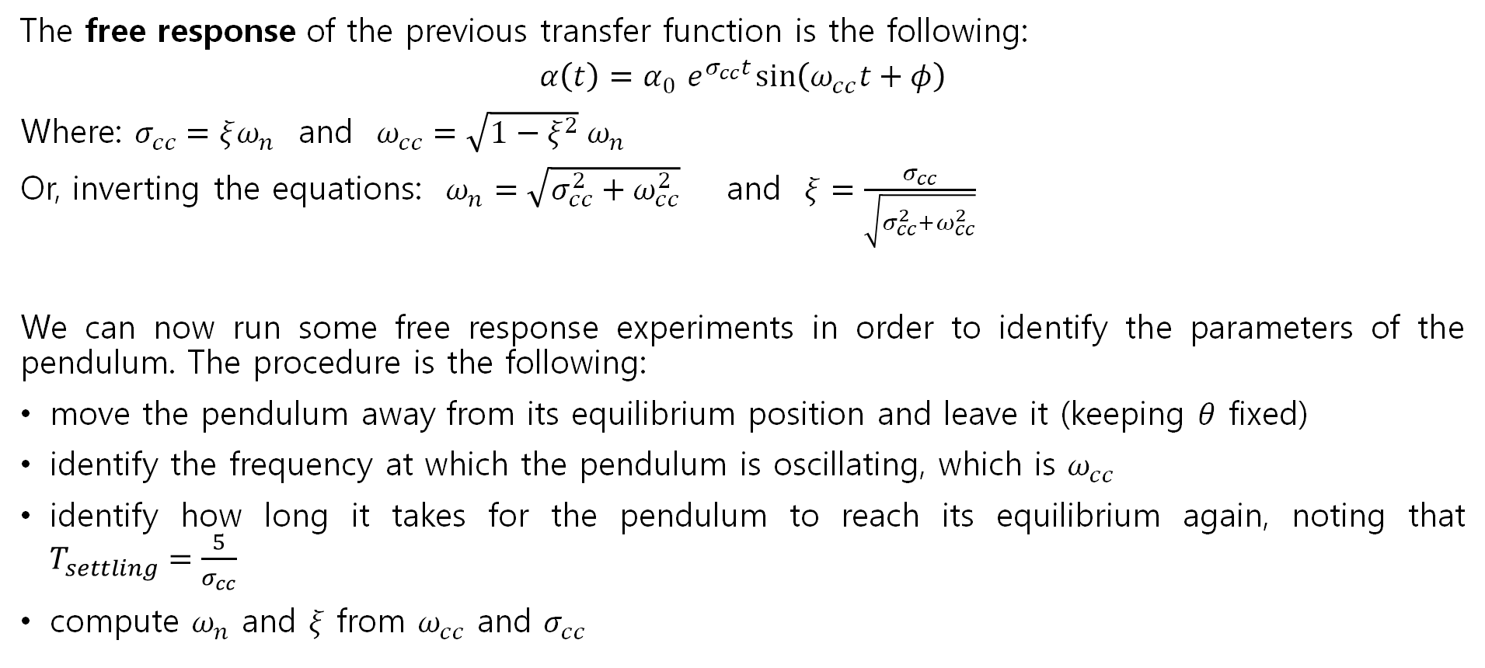
Pendulum Model
The free response of the previous transfer function is the following:
$$α\left(t\right)=α_{0}{ e}^{σ_{cc}t}\sin\left(ω_{cc}t+φ\right)$$
Where: $σ_{cc}=ξω_{n}$ and $ω_{cc}=\sqrt{1−ξ^{2}} ω_{n}$
Or, inverting the equations: $ω_{n}=\sqrt{σ_{cc}^{2}+ω_{cc}^{2}}$ and $ξ=\frac{σ_{cc}}{\sqrt{σ_{cc}^{2}+ω_{cc}^{2}}}$
We can now run some free response experiments in order to identify the parameters of the pendulum. The procedure is the following:
move the pendulum away from its equilibrium position and leave it (keeping $θ$ fixed)
identify the frequency at which the pendulum is oscillating, which is $ω_{cc}$
identify how long it takes for the pendulum to reach its equilibrium again, noting that $T_{settling}=\frac{5}{σ_{cc}}$
compute $ω_{n}$ and $ξ$ from $ω_{cc}$ and $σ_{cc}$

Slide 11
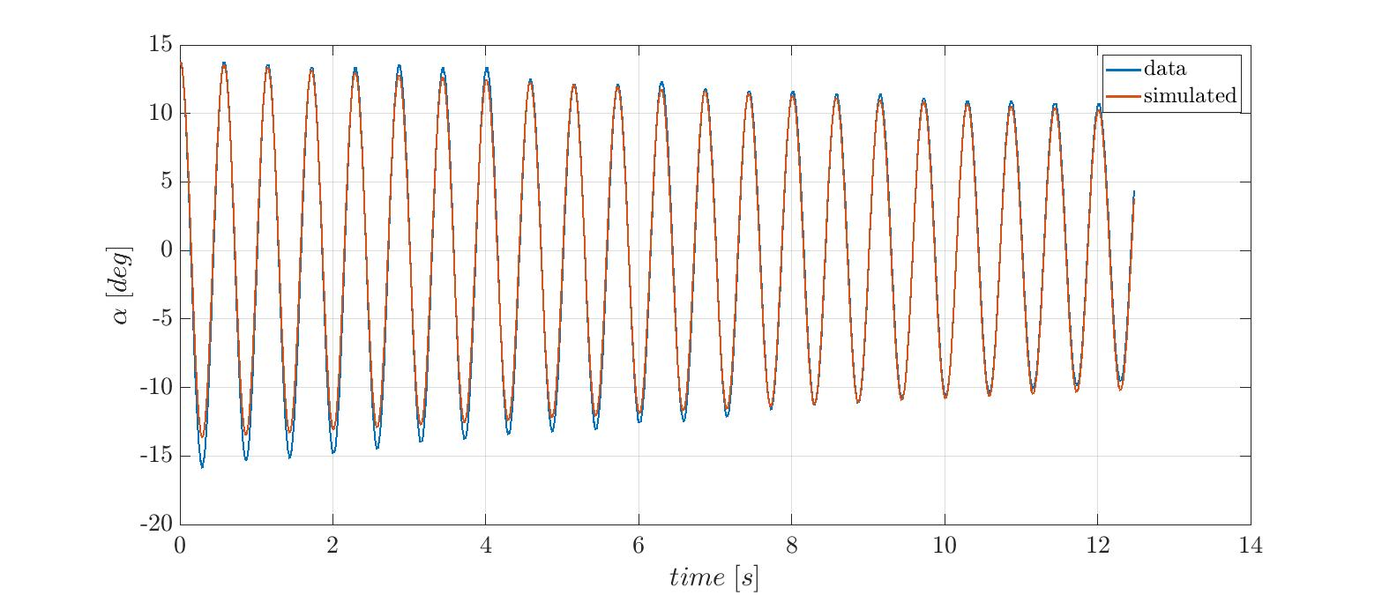
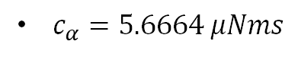
Pendulum Model
Approximate $ℓ_{p}=\frac{L_{p}}{2}$
compute $c_{α}=\frac{2}{3}{ξω_{n}m}_{p}L_{p}^{2}$
$c_{α}=5.6664 μNms$

Slide 12
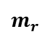
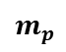

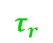
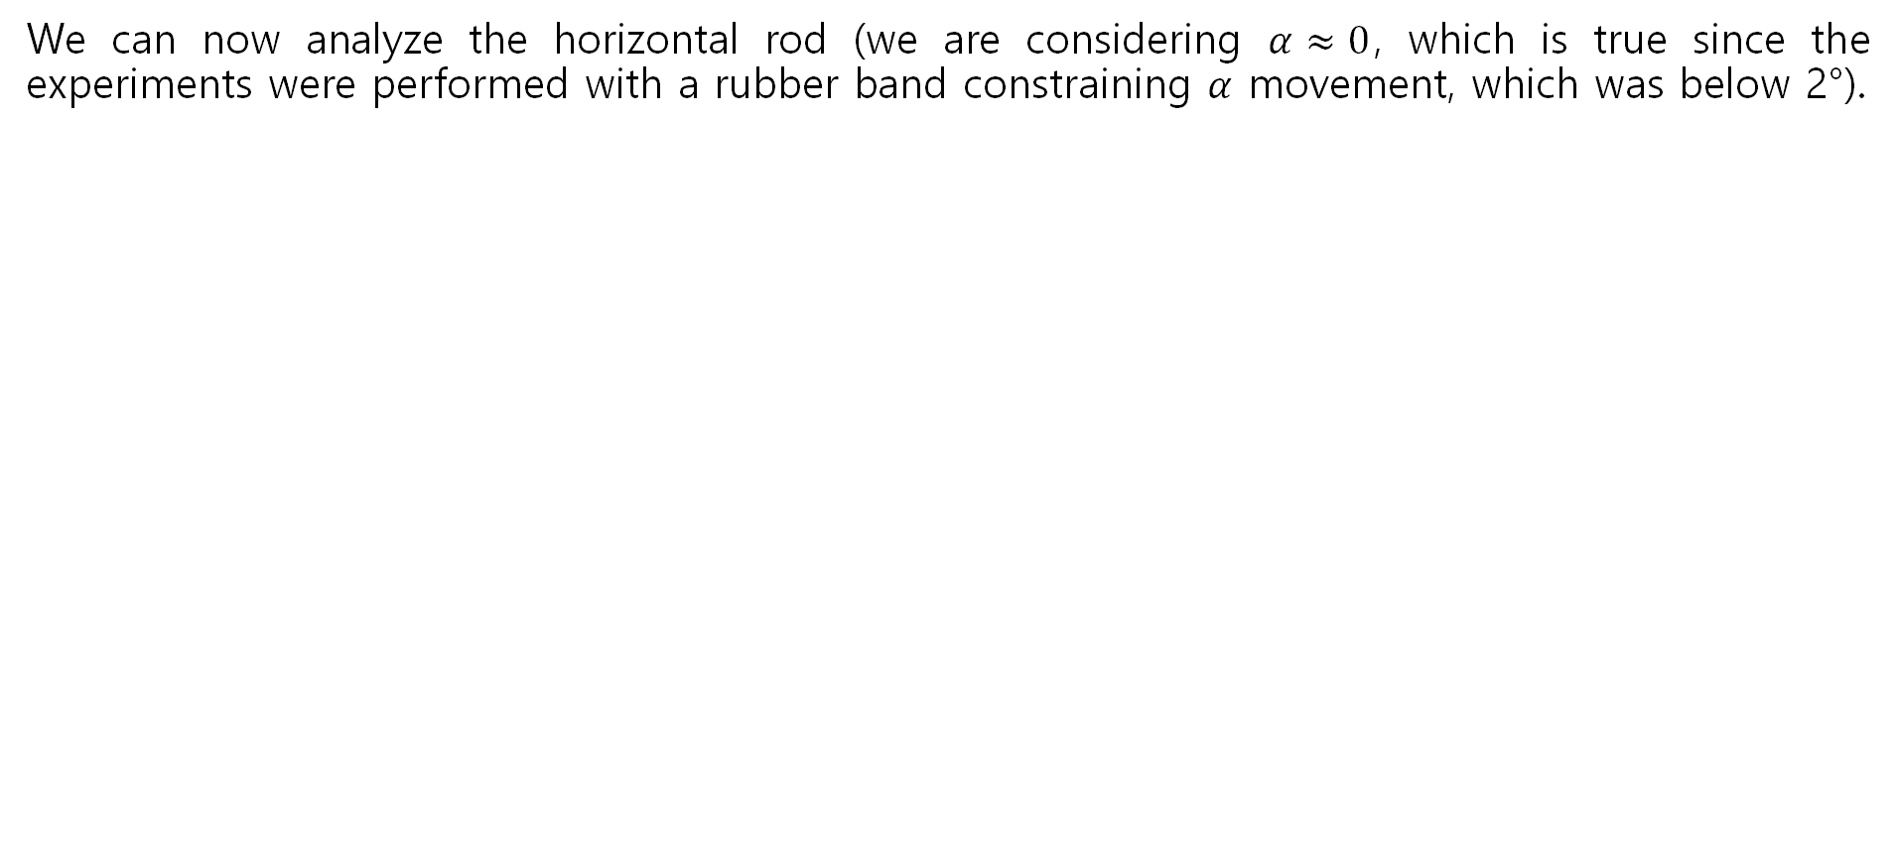
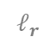



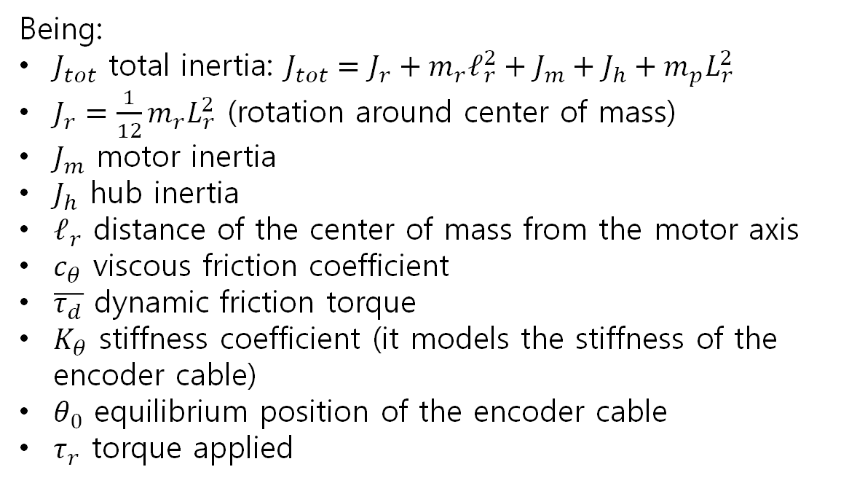
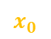
Horizontal Rod Model
We can now analyze the horizontal rod (we are considering $α≈0$, which is true since the experiments were performed with a rubber band constraining $α$ movement, which was below 2°).
$$J_{tot}\ddot{θ}+c_{θ}\dot{θ}+\overline{τ_{d}}\operatorname{sign}{\dot{θ}}+K_{θ}\left(θ−θ_{0}\right)=τ_{r}$$
Being:
$J_{tot}$ total inertia: $J_{tot}=J_{r}+m_{r}ℓ_{r}^{2}+J_{m}+J_{h}+m_{p}L_{r}^{2}$
$J_{r}=\frac{1}{12}m_{r}L_{r}^{2}$ (rotation around center of mass)
$J_{m}$ motor inertia
$J_{h}$ hub inertia
$ℓ_{r}$ distance of the center of mass from the motor axis
$c_{θ}$ viscous friction coefficient
$\overline{τ_{d}}$ dynamic friction torque
$K_{θ}$ stiffness coefficient (it models the stiffness of the encoder cable)
$θ_{0}$ equilibrium position of the encoder cable
$τ_{r}$ torque applied
$$L_{r}$$
$$m_{p}$$
$$ℓ_{r}$$
$$m_{r}$$
$$z_{0}$$
ROD
$$θ$$
$$y_{0}$$
$$x_{0}$$
$$τ_{r}$$

Slide 13
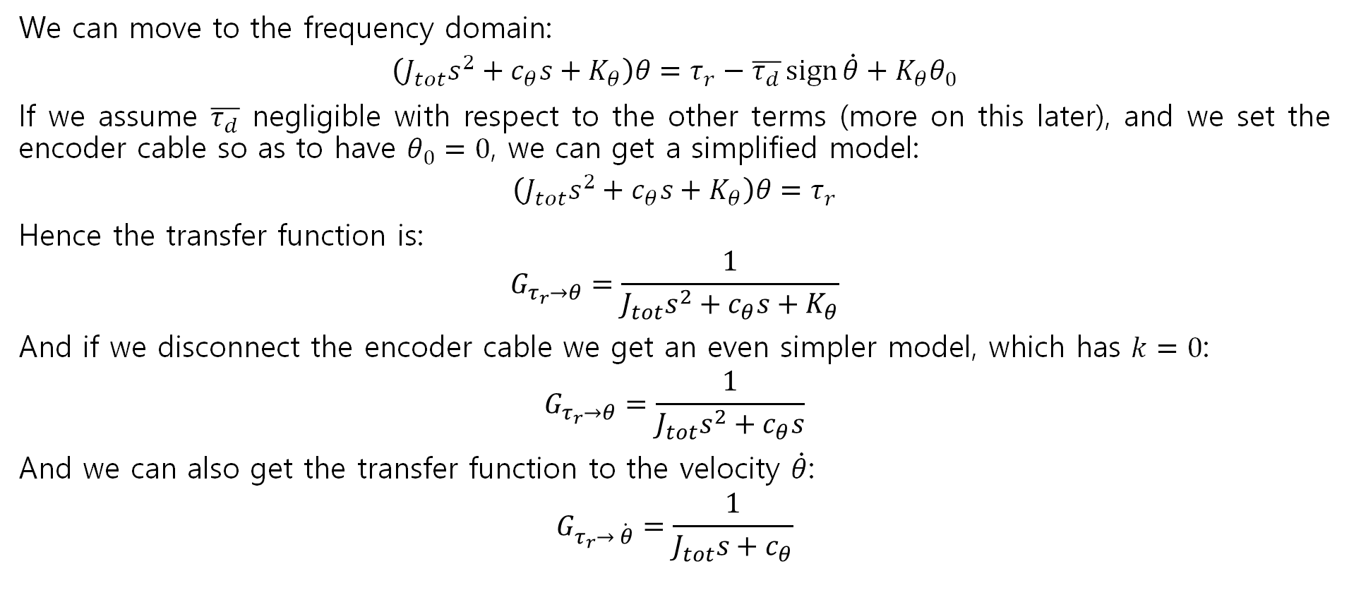
Horizontal Rod Model
We can move to the frequency domain:
$$\left(J_{tot}s^{2}+c_{θ}s+K_{θ}\right)θ=τ_{r}−\overline{τ_{d}}\operatorname{sign}{\dot{θ}}+K_{θ}θ_{0}$$
If we assume $\overline{τ_{d}}$ negligible with respect to the other terms (more on this later), and we set the encoder cable so as to have $θ_{0}=0$, we can get a simplified model:
$$\left(J_{tot}s^{2}+c_{θ}s+K_{θ}\right)θ=τ_{r}$$
Hence the transfer function is:
$$G_{τ_{r}→θ}=\frac{1}{J_{tot}s^{2}+c_{θ}s+K_{θ}}$$
And if we disconnect the encoder cable we get an even simpler model, which has $k=0$:
$$G_{τ_{r}→θ}=\frac{1}{J_{tot}s^{2}+c_{θ}s}$$
And we can also get the transfer function to the velocity $\dot{θ}$:
$$G_{τ_{r}→ \dot{θ}}=\frac{1}{J_{tot}s+c_{θ}}$$

Slide 14
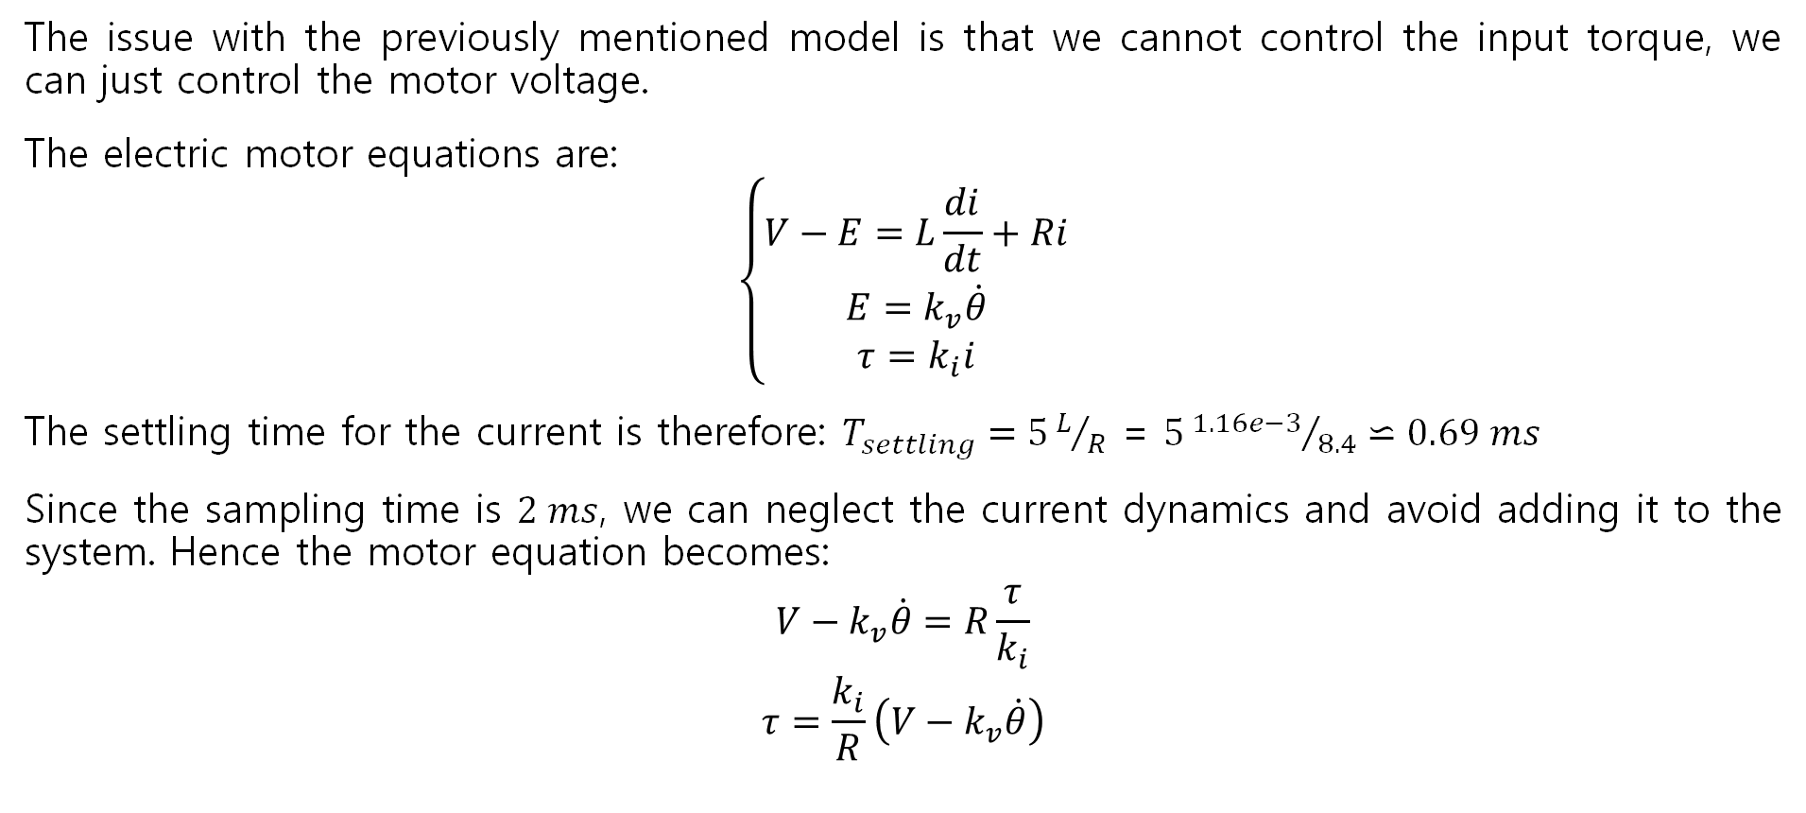
Horizontal Rod Model
The issue with the previously mentioned model is that we cannot control the input torque, we can just control the motor voltage.
The electric motor equations are:
$$\left\{\begin{matrix}V−E=L\frac{di}{dt}+Ri \\ E=k_{v}\dot{θ} \\ τ=k_{i}i\end{matrix}\right.$$
The settling time for the current is therefore: $T_{settling}=5L/R$ = $5{1.16e−3}/{8.4}⋍0.69 ms$
Since the sampling time is $2 ms$, we can neglect the current dynamics and avoid adding it to the system. Hence the motor equation becomes:
$$V−k_{v}\dot{θ}=R\frac{τ}{k_{i}}$$
$$τ=\frac{k_{i}}{R}\left(V−k_{v}\dot{θ}\right)$$

Slide 15
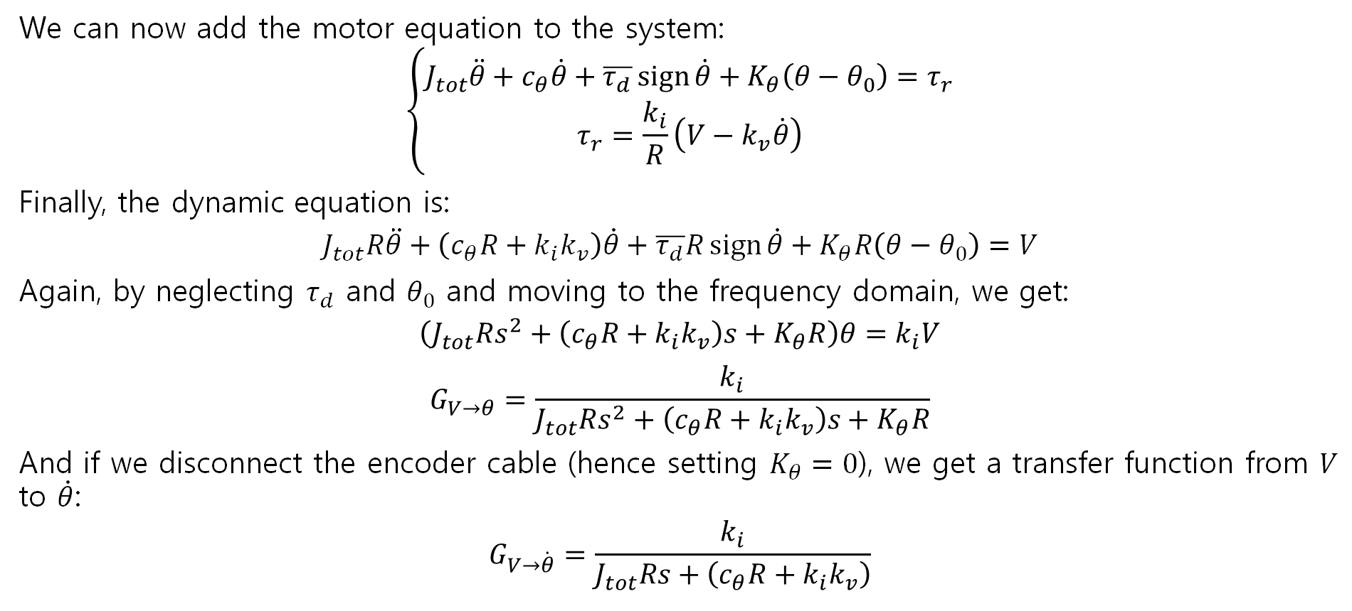
Horizontal Rod Model
We can now add the motor equation to the system:
$$\left\{\begin{matrix}J_{tot}\ddot{θ}+c_{θ}\dot{θ}+\overline{τ_{d}}\operatorname{sign}{\dot{θ}}+K_{θ}\left(θ−θ_{0}\right)=τ_{r} \\ τ_{r}=\frac{k_{i}}{R}\left(V−k_{v}\dot{θ}\right)\end{matrix}\right.$$
Finally, the dynamic equation is:
$$J_{tot}R\ddot{θ}+\left(c_{θ}R+k_{i}k_{v}\right)\dot{θ}+\overline{τ_{d}}R\operatorname{sign}{\dot{θ}}+K_{θ}R\left(θ−θ_{0}\right)=V$$
Again, by neglecting $τ_{d}$ and $θ_{0}$ and moving to the frequency domain, we get:
$$\left(J_{tot}Rs^{2}+\left(c_{θ}R+k_{i}k_{v}\right)s+K_{θ}R\right)θ=k_{i}V$$
$$G_{V→θ}=\frac{k_{i}}{J_{tot}Rs^{2}+\left(c_{θ}R+k_{i}k_{v}\right)s+K_{θ}R}$$
And if we disconnect the encoder cable (hence setting $K_{θ}=0$), we get a transfer function from $V$ to $\dot{θ}$:
$$G_{V→\dot{θ}}=\frac{k_{i}}{J_{tot}Rs+\left(c_{θ}R+k_{i}k_{v}\right)}$$

Slide 16
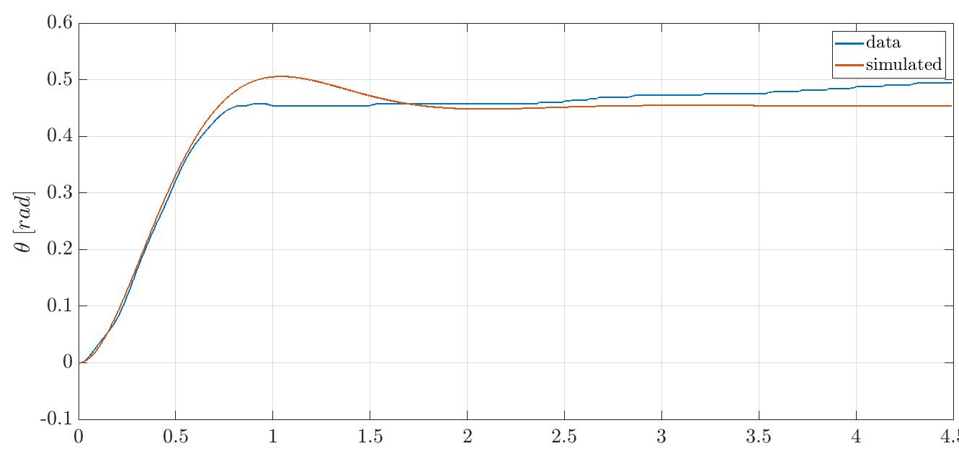
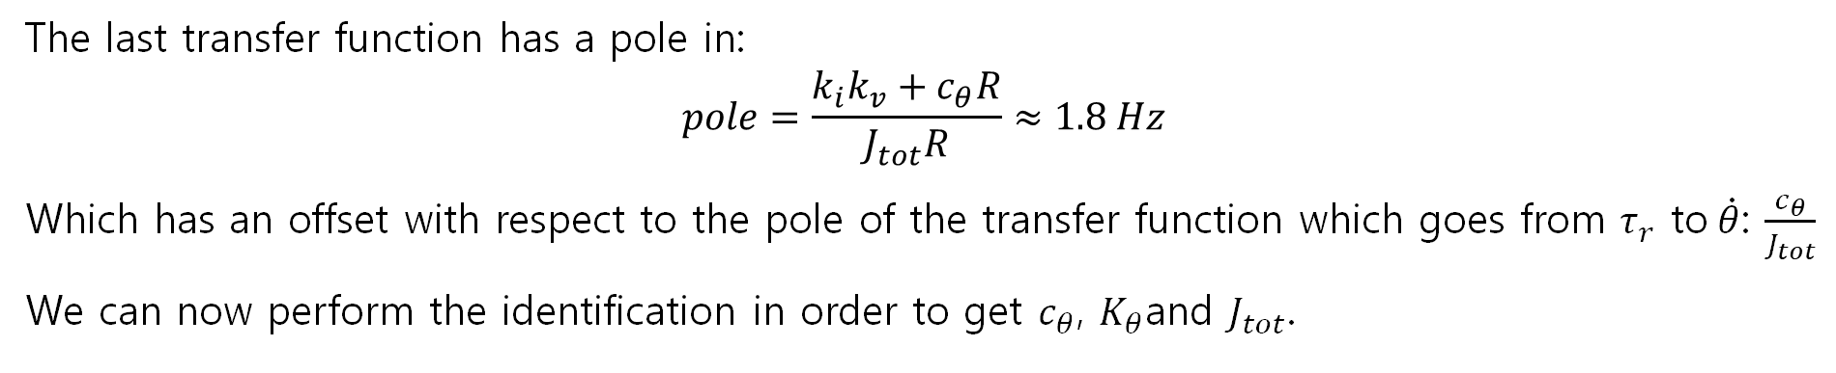
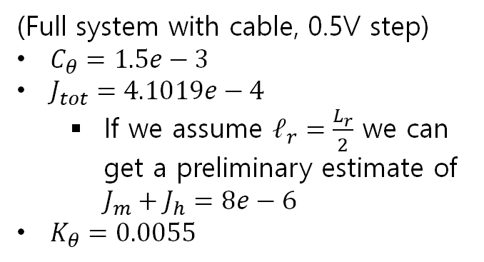
Horizontal Rod Model
The last transfer function has a pole in:
$$pole=\frac{k_{i}k_{v}+c_{θ}R}{J_{tot}R}≈1.8 Hz$$
Which has an offset with respect to the pole of the transfer function which goes from $τ_{r}$ to$\dot{θ}$: $\frac{c_{θ}}{J_{tot}}$
We can now perform the identification in order to get $c_{θ}$, $K_{θ}$and $J_{tot}$.
(Full system with cable, 0.5V step)
$C_{θ}=1.5e−3$
$J_{tot}=4.1019e−4$
If we assume $ℓ_{r}=\frac{L_{r}}{2}$ we can get a preliminary estimate of $J_{m}+J_{h}=8e−6$
$K_{θ}=0.0055$

Slide 17
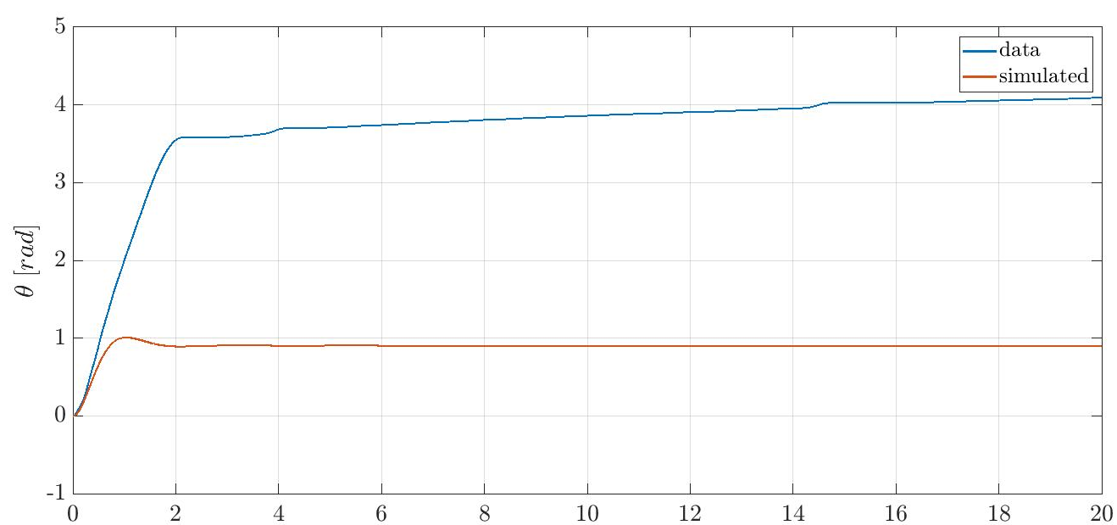
Horizontal Rod Model
However, note that the cable encoder has a very nonlinear behavior which cannot be approximated with a spring. As a matter of fact, when validating on a 1V step experiment, we obtain this:

Slide 18
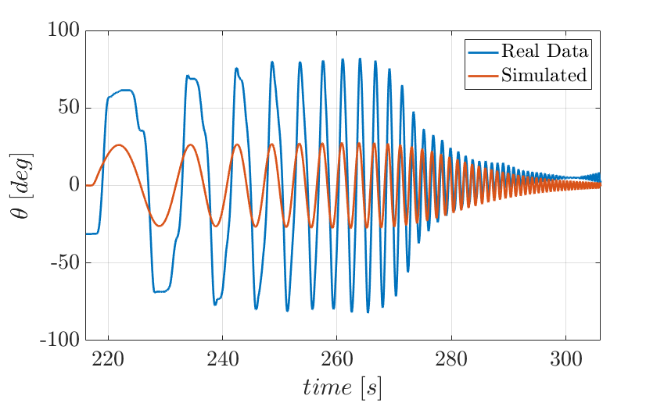
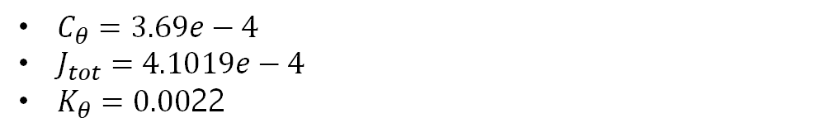
Horizontal Rod Model
Another issue of the identified parameters is that in a sine sweep validation experiment they are performing poorly.
We can re-run the identification for the sine sweep (with the system identification toolbox in MATLAB) and we get the following results:
$C_{θ}=3.69e−4$
$J_{tot}=4.1019e−4$
$K_{θ}=0.00$22

Slide 19
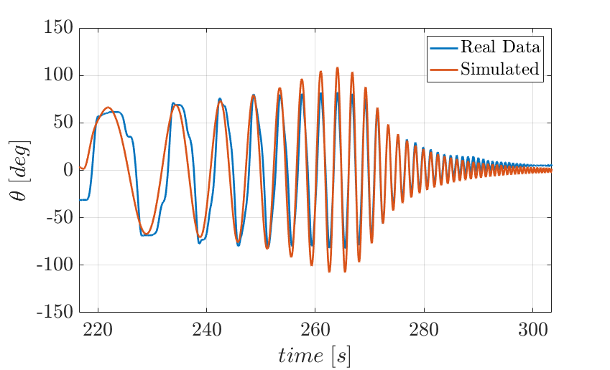
Horizontal Rod Model
The performance is much better:
Notice that in order to run this identification, it was necessary to remove the estimated friction from the estimated $τ_{r}$ applied to the system.

Slide 20
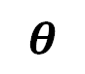

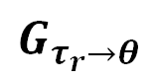
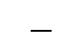
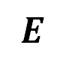







Horizontal Rod Model
Notice that the last model we obtained is assuming that the current dynamics do not affect the system. This can be also proven by computing the complete model according to the following scheme:
$$V$$
$$+$$
$$τ$$
$$θ$$
$$G_{el}$$
$$G_{τ_{r}→θ}$$
$$−$$
$$\dot{θ}$$
$$E$$
$$s$$
$$k_{v}$$
Where:
$$G_{τ_{r}→θ}=\frac{1}{J_{tot}s^{2}+c_{θ}s+K_{θ}}$$
and
$$G_{el}=\frac{k_{i}}{sL+R}$$

Slide 21



Horizontal Rod Model
Hence, the system has a transfer function given by:
$$G_{V→θ}=\frac{G_{el}G_{τ_{r}→θ}}{1+{sk}_{v}G_{el}G_{τ_{r}→θ}}=\frac{1}{\frac{1}{G_{el}G_{τ_{r}→θ}}+{sk}_{v}}$$
And replacing the expressions we get:
$$G_{V→θ}=\frac{k_{i}}{J_{tot}L{ s}^{3}+\left(J_{tot}R+c_{θ}L\right)s^{2}+\left(LK_{θ}+c_{θ}R+k_{i}k_{v}\right)s+RK_{θ}}=$$
$$=\frac{R}{sL+R} \frac{\frac{k_{i}}{R}}{\left(J_{tot}s^{2}+c_{θ}s+K_{θ}\right)+s\frac{k_{i}k_{v}}{R} \frac{R}{sL+R}}≈$$
$$≈\frac{k_{i}}{J_{tot}Rs^{2}+\left(c_{θ}R+k_{i}k_{v}\right)s+K_{θ}R}$$
We got the same equation as before.
$$≈1$$
$$≈1$$

Slide 22












Static Friction Identification
We now want to add static friction to the model.
As previously mentioned, we can synthetize the model as follows:
Where $G_{el}=\frac{k_{i}}{sL+R}$ , so we can compute $τ$ by measuring $V$ as: ${τ=G}_{el}\left(V−k_{v}\dot{θ}\right)$, where $\dot{θ}$ can be computed offline.
In order to identify the static friction, we can increase gradually $V$ up to the moment in which $θ$ starts moving. Then we know the value of $τ_{r}$ such that, if $τ_{r}<τ_{threshold}$ we have no movement in $θ$. $τ_{threshold}$ is the value of the static friction we are looking for.
By repeating the experiment four times, we get $τ_{threshold}=7.9 {10}^{−4} Nm$
Finally, we can set the dynamic friction torque as $0.85∙τ_{threshold}$
$$V$$
$$+$$
$$τ$$
$$G_{el}$$
$$G_{τ_{r}→θ}$$
$$θ$$
$$−$$
$$E$$
$$s$$
$$\dot{θ}$$
$$k_{v}$$

Slide 23

Complete System Optimization
Finally, let us consider the overall system.
We cannot easily identify the parameters on the overall system, hence we will write the problem as an optimization problem and run a suitable optimizer so as to solve the problem.
PROBLEM STATEMENT:
$$\min_{k_{i} ∈ K}\left(a_{θ}∙\operatorname{rms}\left(θ−\hat{θ}\right)+a_{\dot{θ}}∙\operatorname{rms}\left(\dot{θ}−\hat{\dot{θ}}\right)+a_{α}∙\operatorname{rms}\left(α−\hat{α}\right)+a_{\dot{α}}∙\operatorname{rms}\left(\dot{ α}−\hat{\dot{α}}\right)\right)$$
Where $k_{i}$ is a parameter to be tuned, which has some optimization limits defined in $K$.
All the variables with a “hat” are the outputs of a full-fledged simulator (see later). Therefore, in the cost function we are weighting the difference between the real and the simulated data, multiplied for some weighting coefficients.

Slide 24


Complete System Optimization – Fast Dynamics
The first optimization is performed in order to optimize the fast dynamics of the system, which are given mostly by the viscous friction and inertias of the system.
The first set of parameters to be optimized is therefore $ℓ_{p},ℓ_{r}, J_{h},c_{θ}, c_{α}$.
The chosen range for the optimization is $\left[0.5 1.5\right]∙k_{i_{nominal value}}$ for each optimization variable.
The weights which were used in this optimization were: $a_{θ}=0, a_{\dot{θ}}=0.5,$ $a_{α}=1, a_{\dot{α}}=0.05$
In particular $a_{θ}=0$ since $θ$ tends to drift over time, so we are only weighting its velocity (since the drift is a low frequency behavior caused by non-linearities of the encoder cable and friction).
The chosen dataset is a voltage sweep sine, so as to validate all frequencies.

Slide 25
Complete System Optimization – Fast Dynamics
Optimization run
The low frequency sinusoids are not that accurate, due to the presence of friction and non linearities (for example the encoder cable, modeled as a spring). At high frequency the simulator is quite accurate.

Slide 26


Complete System Optimization – Fast Dynamics

Slide 27


Complete System Optimization – Fast Dynamics
$θ$ has an offset, this is why we are only weighting its derivative
The simulated resonance is close to the real one (almost perfect results could be obtained by using datasets with smaller $α$, but they did not perform well for higher $α$ angles)

Slide 28

Complete System Optimization – Fast Dynamics
We can also take a look at the velocity profile in the resonance, which is quite accurate.

Slide 29


Complete System Optimization – Slow Dynamics
We can perform the same optimization also for the slow dynamics.
In particular, the optimization variables in this case are:$\overline{τ_{d}},\overline{τ_{s}},K_{θ}$
The chosen range for the optimization is $\left[0.5 1.5\right]∙k_{i_{nominal value}}$ for each optimization variable.
The weights which were used in this optimization were: $a_{θ}=1, a_{\dot{θ}}=1,$ $a_{α}=0, a_{\dot{α}}=0$ (we do not want to estimate correctly $α$ but just the slow dynamics of $θ$).
The selected dataset in this case was a sequence of steps and ramps (for the estimation of slow dynamics only the ramps are needed, but due to static friction non linearities also the steps were used, so as to obtain better overall performance. In any case, this optimization was run after the fast dynamics one).

Slide 30

Complete System Optimization – Slow Dynamics
The result is not that accurate due to the following facts:
the real behavior of the encoder cable cannot be approximated with a spring, since it depends on $θ$ and it is even asymmetric
The static friction depends on $θ$ (notice the difference in static friction in the first two steps with respect to the one in the first ramp)

Slide 31
SIMULATOR
DESIGN

Slide 32

Simulator
In order to get the solution to the complete model, we used the following procedure:
Write the system with the Symbolic Toolbox in MATLAB
Obtain a non-linear system $B\left(q\right)\ddot{q}+C\left(q,\dot{q}\right)\dot{q}+g\left(q\right)+C_{v}\dot{q}+K\left(q−q_{0}\right)=T$
Write the system as: $\ddot{q}=B{\left(q\right)}^{−1}\left(T−C\left(q,\dot{q}\right)\dot{q}−g\left(q\right)−C_{v}\dot{q}−K\left(q−q_{0}\right)\right)$
Now we can compute $\ddot{q}$ starting from $\dot{q}$ and $q$
$T$ is computed as $T=\left[\begin{aligned}τ_{filt} \\ 0\end{aligned}\right]$ where $τ_{filt}=τ_{motor}−τ_{StaticFriction}−τ_{DynamicFriction}$
Add the motor dynamics from $V$ to $τ_{motor}$
The last missing item is the saturation logic on $θ$, which is the following:
$\dot{θ}$ is set to 0 as soon as $θ$ saturates
An external torque is added which compensates $τ_{motor}−K_{θ}\left(θ−θ_{0}\right)$

Slide 33














Simulator
Graphically (saturation logic on $θ$ is not reported):
$$\dot{θ}$$
$$\ddot{θ}$$
$$\frac{1}{s}$$
$$\dot{θ}$$
$$\frac{1}{s}$$
$$θ$$
$$V$$
Motor Model
$$τ$$
Acceleration Computation
$$\ddot{α}$$
$$\frac{1}{s}$$
$$\dot{α}$$
$$\frac{1}{s}$$
$$α$$

Slide 34
CONTROLLER
DESIGN

Slide 35


Controller Design
Since we have a symbolic description of the system in MATLAB, we can proceed as follows:
Write the non linear system as $\dot{x}=f\left(x, u\right)$ being $x=\left[\begin{matrix}θ \\ \begin{matrix}\dot{θ} \\ α\end{matrix} \\ \dot{α}\end{matrix}\right]$ and $u=V$ (notice that the simplified relation $τ=\frac{k_{i}}{R}\left(V−k_{v}\dot{θ}\right)$ is used
Find the equilibrium positions of the system by setting $f\left(x, u\right)=0$, which are:
$$x_{eq_{1}}=\left[\begin{matrix}\frac{k_{i}V_{eq}}{K_{θ}R} \\ \begin{matrix}0 \\ 0\end{matrix} \\ 0\end{matrix}\right],{ x}_{eq_{2}}=\left[\begin{matrix}\frac{k_{i}V_{eq}}{K_{θ}R} \\ \begin{matrix}0 \\ π\end{matrix} \\ 0\end{matrix}\right]$$
Linearize the system around the equilibrium:
$$\dot{x}⋍f\left(x_{eq},u_{eq}\right)+{\left.\frac{∂f\left(x, u\right)}{∂x}\right|}_{\begin{matrix}x=x_{eq} \\ u=u_{eq}\end{matrix}}\left(x−x_{eq}\right)+{\left.\frac{∂f\left(x, u\right)}{∂u}\right|}_{\begin{matrix}x=x_{eq} \\ u=u_{eq}\end{matrix}}\left(u−u_{eq}\right)$$
$$=0$$

Slide 36


Controller Design
Hence, if we define:
$$A={\left.\frac{∂f\left(x, u\right)}{∂x}\right|}_{\begin{matrix}x=x_{eq} \\ u=u_{eq}\end{matrix}} B={\left.\frac{∂f\left(x, u\right)}{∂u}\right|}_{\begin{matrix}x=x_{eq} \\ u=u_{eq}\end{matrix}}$$
$$C=\left[\begin{matrix}1 & \begin{matrix}0 & 0\end{matrix} & 0 \\ 0 & \begin{matrix}0 & 1\end{matrix} & 0\end{matrix}\right] D=\left[\begin{matrix}0 & 0 \\ 0 & 0\end{matrix}\right]$$
Now we have a linearized system around the chosen equilibrium.
Moreover, it can be noticed that the matrices $A$ and $B$ do not depend on $V_{eq}$ and $θ_{eq}$, since the only place where $θ$ is present is:
$$A=\left[\begin{matrix}∙ & \begin{matrix}∙ & ∙\end{matrix} & ∙ \\ \begin{matrix}∙ \\ ∙\end{matrix} & \begin{matrix}∙ & ∙+∙\left(V_{eq}−\frac{K_{θ}θ_{eq}R}{k_{i}}\right)\sin{α} \\ ∙ & ∙\end{matrix} & \begin{matrix}∙ \\ ∙\end{matrix} \\ ∙ & \begin{matrix}∙ & ∙+∙\left(V_{eq}−\frac{K_{θ}θ_{eq}R}{k_{i}}\right)\sin{α}\end{matrix} & ∙\end{matrix}\right]$$
At the equilibrium $α=0$ or $α=π$ and
$V_{eq}−\frac{K_{θ}θ_{eq}R}{k_{i}}=0$ so this term is not present

Slide 37
Control objectives
The control tasks to be accomplished are:
✅ Position control of the horizontal arm
✅ Stabilization of the vertical arm in the upright position
✅ Position control of the horizontal arm while keeping the vertical arm in the upright position
✅ Swing-up of the vertical arm
We will now discuss the control schemes used for each task…

Slide 38

POSITION CONTROL OF $θ$

Slide 39




Position control of the horizontal arm (1)
We designed our controller in worst case scenario in which the low-frequency pole is actually an integrator, obtaining, in this way, a double integrator
Horizontal rod model:
$$G_{V→θ}=\frac{k_{i}}{s (J_{tot}Rs+\left(c_{θ}R+k_{i}k_{v}\right))} ≈\frac{k_{i}}{J_{tot} R{ s}^{2}}$$
Our first approach for the horizontal arm position control was a PD controller to add a low-frequency zero to increase the phase margin
$$R_{PD}\left(s\right)=P+D \frac{N}{1+N \frac{1}{s}}$$
To tune the PD controller, we need values for the $P$, $D$ and $N$ parameters. When actually tuning, we used more meaningful parameters, such as:
Cutting frequency of the loop transfer function
Ratio between low-frequency zero and cutting frequency
Ratio between high-frequency pole and cutting frequency
$$P= \frac{ω_{c} J_{tot} R }{k_{i}} ; N= \frac{\left({ω_{p}}/{ω_{c}}\right) J_{tot}R}{k_{i}} \\ D= \frac{\left(\left({ω_{c}}/{ω_{z}}\right)\left({ω_{p}}/{ω_{c}}\right) −1\right)J_{tot }R}{\left({ω_{p}}/{ω_{c}}\right)k_{i}}$$

Slide 40



Position control of the horizontal arm (2)
We conducted two experiments on the PD controller:
Step response: 45° constant theta reference
Dynamic response: varying theta reference
The poor performances of the controller are due to the lack of an integrator in the regulator, that is needed to achieve zero steady-state error. In fact, the integrator provides infinite rejection to the constant disturbances that affect the control action
For this reason, we designed a PID controller
$$R_{PD}\left(s\right)=P+I \frac{1}{s}+D \frac{N}{1+N \frac{1}{s}}$$

Slide 41


Position control of the horizontal arm (3)
For the PID controller, we followed the same tuning logic as for the PD controller
We performed three set of experiments on the PID controller:
Step response: 45° constant theta reference
Dynamic response: varying theta reference

Slide 42

STABILIZATION OF $α$

Slide 43


Stabilization of the horizontal arm in upright position (1)
First of all, we linearized the system in the upright position, which is an unstable equilibrium point
Hence, we define:
$A={\left.\frac{∂f\left(x, u\right)}{∂x}\right|}_{\begin{matrix}x=x_{eq} \\ u=u_{eq}\end{matrix}} B={\left.\frac{∂f\left(x, u\right)}{∂u}\right|}_{\begin{matrix}x=x_{eq} \\ u=u_{eq}\end{matrix}}$ where $x=\left[\begin{matrix}θ \\ \begin{matrix}\dot{θ} \\ α\end{matrix} \\ \dot{α}\end{matrix}\right]$, $x_{eq}=\left[\begin{matrix}θ \\ \begin{matrix}0 \\ π\end{matrix} \\ 0\end{matrix}\right]$ and $u= τ$
The first control algorithm we designed for this task was a pole placement method based only on alpha dynamics. To achieve better rejection to disturbances, we introduced an integrator in the system.
Control scheme:
For tuning purposes, we set the positions of the three poles defined by the pole placement method

Slide 44



Stabilization of the horizontal arm in upright position (2)
In the laboratory, we tested if the algorithm successfully stabilizes the pendulum in the upright position
The algorithm stops working when theta saturates. This will always happen as the theta dynamic is not controlled.
In order to continuously stabilize the pendulum, it's necessary to also control the $θ$ dynamics. For this reason, we developed a full-state pole placement method that will be used to achieve the third control objective.

Slide 45
FULL STATE FEEDBACK

Slide 46

Position control of the horizontal arm while keeping the vertical arm in the upright position – LMI (1)
To design the full-state pole placement method, we used Linear Matrix Inequalities (LMI). LMI provide a state-feedback gain by solving a constrained optimization problem. The constraint we imposed regard:
Minimization of the control effort
Damping of the poles
Settling time
The tuning of the algorithm was performed on the values of the parameters for the aforementioned constraints.
Paper: LMI Pole Regions for a Robust Discrete-Time Pole Placement Controller Design
Control scheme:

Slide 47




Position control of the horizontal arm while keeping the vertical arm in the upright position – LMI (2)
To test this algorithm, two experiments were performed:
Theta constant reference of 0° (to completely achieve the second control objective)
Dynamic response: varying theta reference

Slide 48


Position control of the horizontal arm while keeping the vertical arm in the upright position – LMI (3)
The tracking of $θ_{ref}$ is not accurate. Hence, we added an integrator in the system to enhance the controller performances.
In addition, a smart saturation was also implemented in the following pole-placement plus integrator control scheme.
The purpose of the smart saturation is to prioritize the system stabilization.
This means that the control action is firstly allocated by the system stabilization loop in order to correctly stabilize the pendulum.
Then, the remaining control action is used by the theta integrator controller to track the theta reference.
An anti wind-up technique is also present.
Anti wind-up
Integrator

Slide 49


Position control of the horizontal arm while keeping the vertical arm in the upright position – LMI (4)
We performed several dynamical tests on this algorithm, here we present the best results we obtained

Slide 50



Position control of the horizontal arm while keeping the vertical arm in the upright position - LQ (1)
We also approached this problem with an LQ controller
We set $T_{settling}=1 s$
$Q=diag\left(1 0.01 1 0.01\right)$
$R=1$

Slide 51



Position control of the horizontal arm while keeping the vertical arm in the upright position - LQ (2)
For a better tracking of $θ$, we added an integrator to the linearized system as a fictitious state
We set $T_{settling}=2 s$
$Q=diag\left(0.1 0.01 1 0.01 0.1\right)$
$R=1$

Slide 52
PENDULUM OSCILLATIONS MINIMIZATION

Slide 53


Pendulum Oscillations Minimization – LMI
With the same algorithm, we successfully improved the results obtained for the first control objective.
In particular, we achieved the advanced task of controlling the horizontal arm position while minimizing the oscillations produced by the pendulum.
This was possible thanks to LMI techniques, by using linearized matrices around the downright position of the pendulum and imposing, in this way, a sufficiently high damping on the alpha poles.
The tests below show how the system response has significantly improved (this test was conducted without an integrator in the system)

Slide 54



Pendulum Oscillations Minimization (1)
In order to minimize $α$while controlling $θ$, we used a LQ approach, applied to the linearized system (without integrator) ($α=0$)
We set:
$T_{settling}=1 s$
$Q=diag\left(1, 0.01, 1, 0.01\right)$
$R=1$

Slide 55

Pendulum Oscillations Minimization (1)
In order to minimize $α$while controlling $θ$, we used a LQ approach, applied to the linearized system (without integrator) ($α=0$)
We set:
$T_{settling}=1 s$
$Q=diag\left(1, 0.01, 1, 0.01\right)$
$R=1$

Slide 56




Pendulum Oscillations Minimization (2)
For a better tracking of $θ$, we added an integrator to the linearized system as a fictitious state
$T_{s}=1.5s,$ $Q=diag\left(1 0.01 1 0.01 0.1\right),$ $R=1$
$T_{s}=1.5s,$ $Q=diag\left(1 0.01 1000 0.01 0.1\right),$ $R=10$

Slide 57
SWING-UP

Slide 58

Swing-up of the vertical arm (1)
The first approach we adopted for the swing-up of the pendulum consists in a switching controller.
This controller is composed of:
Open-loop controller: it computes a voltage reference that is a step sequence. In particular, if the alpha velocity is changing sign or if theta is higher than a certain value, the voltage reference changes its sign.
Stabilizing closed-loop controller of the pendulum in upright position
Switching policy: when the pendulum is near the upright position, it switches from the open loop controller to the stabilizing one
Control scheme:

Slide 59




Swing-up of the vertical arm (2)
We present here the results obtained:

Slide 60
CONCLUSIONS

Slide 61


Chattering problem on control variable
For all the state-space controllers, we have a filtered derivative approach for the computation of the angular velocities. Because of quantization and noise in the data, these derivatives are quite noisy.
Consequently, the control output has great oscillations at high frequency (chattering)
Before implementing more advanced estimation techniques for the derivatives, we have tested a solution in which we just low-pass filter the control action. This results in a trade-off between performances and control action chattering.

Slide 62
Next steps
Control:
Tuning of the closed-loop parameters
Other estimation techniques (Kalman filter)
Energy methods for swing-up
Only one controller for swing-up
Modelling:
Perform high frequency optimizations with sine sweeps which start at higher frequencies (so as to better separate lower and higher frequencies)
For friction identification a Bayesian Optimization could lead to better results with respect to gradient based optimization, since the loss function is non-convex

